Slide 1
UCLA STATS C161 / C261
Can AI Beat the Crowd?
Are prediction-market prices good probabilities,
and can a model do better?
Leo Wong / Aaron Wen / Jiahong Chen
Polymarket midterm project
Notes:
LEO (0:30). Hi everyone, we are Leo, Aaron and Jiahong. Polymarket is a prediction market where a share pays one dollar if an event happens. Our question: is the price a good probability, and can a model do better than the crowd?

Slide 2
Market prices and wallet behavior
Market prices
Wallet behavior
Do market prices match observed outcomes?
Can recalibration or boosting improve accuracy?
How well do wallet traits predict average purchase price?
Does boosting improve on linear regression?
Final project direction: combine market and wallet evidence to investigate informed trading.
Notes:
LEO (0:30). Two parts. Aaron looks at market prices: are they calibrated, and can recalibration or boosting beat them? Jiahong looks at wallets: which traits predict the price a wallet pays? For the final we combine both to look for informed trading, and to spot an informed trader we first need to know how good the price already is.

Slide 3
Prior research
Study | Main finding
Thaler & Ziemba (1988) | Betting markets can show pricing anomalies.
Snowberg & Wolfers (2010) | Longshots tend to be overbet and favorites underbet.
Wolfers & Zitzewitz (2004) | Prediction markets often produce accurate forecasts.
Page & Clemen (2013) | Calibration tends to improve closer to expiry.
Sources: JEP 2(2):161–174; JPE 118(4):723–746; JEP 18(2):107–126; Economic Journal 123(568):491–513
Notes:
LEO (0:45). Four papers frame our work. Thaler and Ziemba surveyed racetrack and lottery betting and the pricing anomalies there. Snowberg and Wolfers describe the favorite-longshot bias: long shots are bet too much and favorites too little. Wolfers and Zitzewitz conclude that prediction markets are usually fairly accurate. Page and Clemen ask our exact question and find prices are reasonably calibrated near expiry but biased for events far away. Aaron tests whether Polymarket in 2026 behaves the same way.

Slide 4
Prices as probabilities
E[profit] = p − c
Calibration
Among events priced at 30%,
do about 30% resolve Yes?
A Yes share pays $1 if the event occurs.
p is your belief. c is the price.
Model comparison
Can a model improve on the price
using information available at the time?
Expected profit is per share before trading costs.
Notes:
AARON (0:45). Thank you, Leo. As Leo mentioned, our question is whether prediction-market prices are good probabilities. On Polymarket, a Yes share pays one dollar if the event happens. Suppose a share costs 40 cents, but you believe the chance is 60 percent. Then buying it is profitable on average. This is the formula on the slide: expected profit equals p, your belief, minus c, the price. Traders keep buying or selling until the price matches the crowd's belief. So the price can be read as a probability, and we can test it. We ask two questions. First, is the price calibrated? Second, can a model do better?

Slide 5
Market data and evaluation
7,479 markets
Evaluation
Resolved Yes/No markets
Politics, Technology, Entertainment, Economy
Markets closing June–October 2026
Compare prices with resolved outcomes.
Use calibration curves and Brier scores.
Resample whole events for uncertainty.
4.1M trades
Order-book check
Last trade before 6h, 24h, 3d, and 7d
before market close
Covers 22% of markets. Where both exist:
correlation 0.92, median gap 0.9¢.
Categories come from Polymarket event tags. Brier score is the mean squared gap between price and outcome.
Notes:
AARON (0:50). Here is our data. We used all Yes/No markets in our four categories that closed between June and October 2026. This gives 7,479 markets. For each market, we recorded the price at four points before it closed: seven days, three days, one day, and six hours. The price is the last trade before each point, from 4.1 million trades. We also checked the order book. It covers only 22 percent of these markets, but where both exist, the two prices agree closely, with a correlation of 0.92.

Slide 6
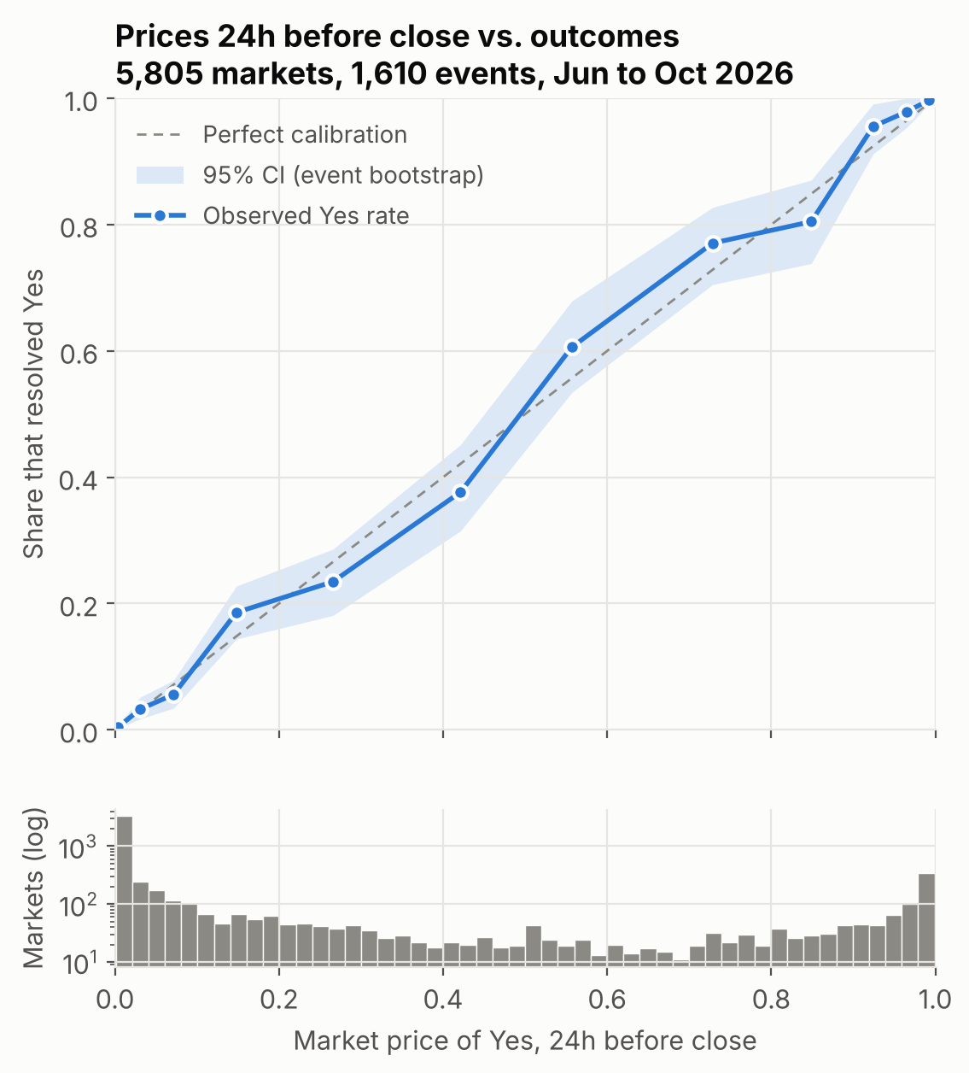
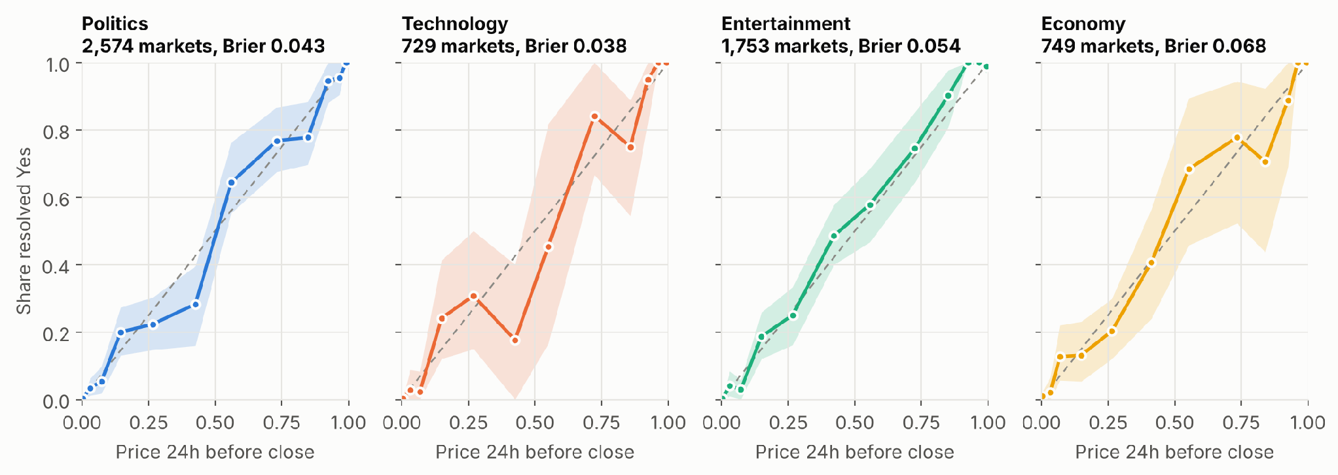
Market calibration
Observed outcomes broadly track
market probabilities.
Events priced near 30% resolve Yes
about 30% of the time.
24 hours before close. 5,805 markets across 1,610 events. Shaded bands: event-bootstrap 95% intervals.
Notes:
AARON (0:50). This figure shows our main result. We group markets by their price one day before close. Then we check how often each group actually happened. If prices are calibrated, the points lie on the diagonal, and they do. When the market says 30 percent, the event happens about 30 percent of the time. The same holds in all four categories, shown on the right. The shaded band is a 95 percent interval. We resample whole events, not single markets, because markets in one event are linked. For example, only one film can win Best Picture.

Slide 7
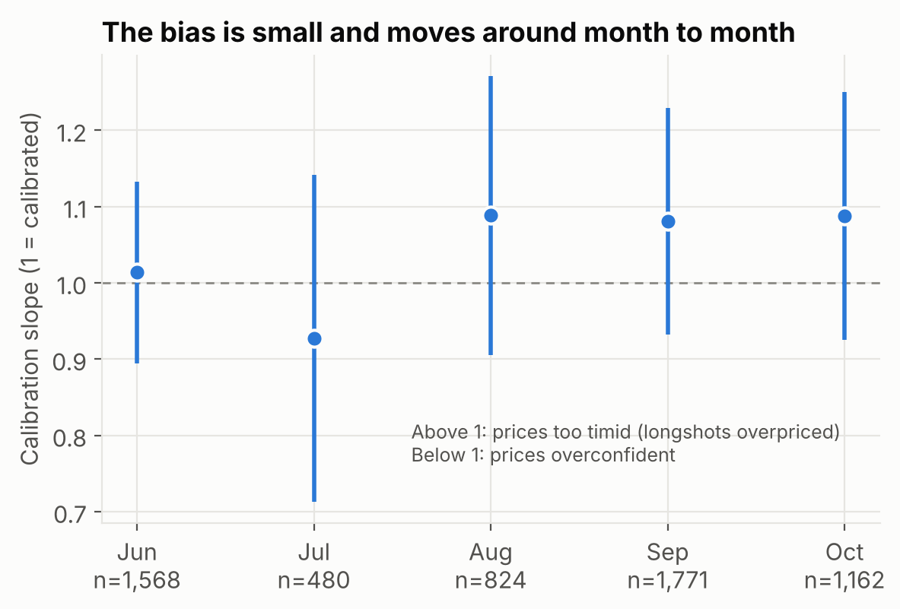
Favorite–longshot bias
1.08
6h calibration slope, all prices
95% interval: 1.01 to 1.16
1.00
After dropping prices
below 2¢ and above 98¢
The estimated bias is small. At 24h, monthly slopes range from 0.93 to 1.09, and every interval includes 1.
Notes:
AARON (1:00). Next, we test the favorite-longshot bias that Leo introduced. We summarize calibration with one number: the slope from a logistic regression of the outcome on the price. A slope of one is perfect. A slope above one means long shots are overpriced. Six hours before close, the slope is 1.08, which is a small sign of the bias. However, it comes only from extreme prices, below 2 cents or above 98 cents. Without them, the slope is 1.00. The slope also changes from month to month, between 0.93 and 1.09, and every monthly interval includes one. So the bias is small and not stable.

Slide 8
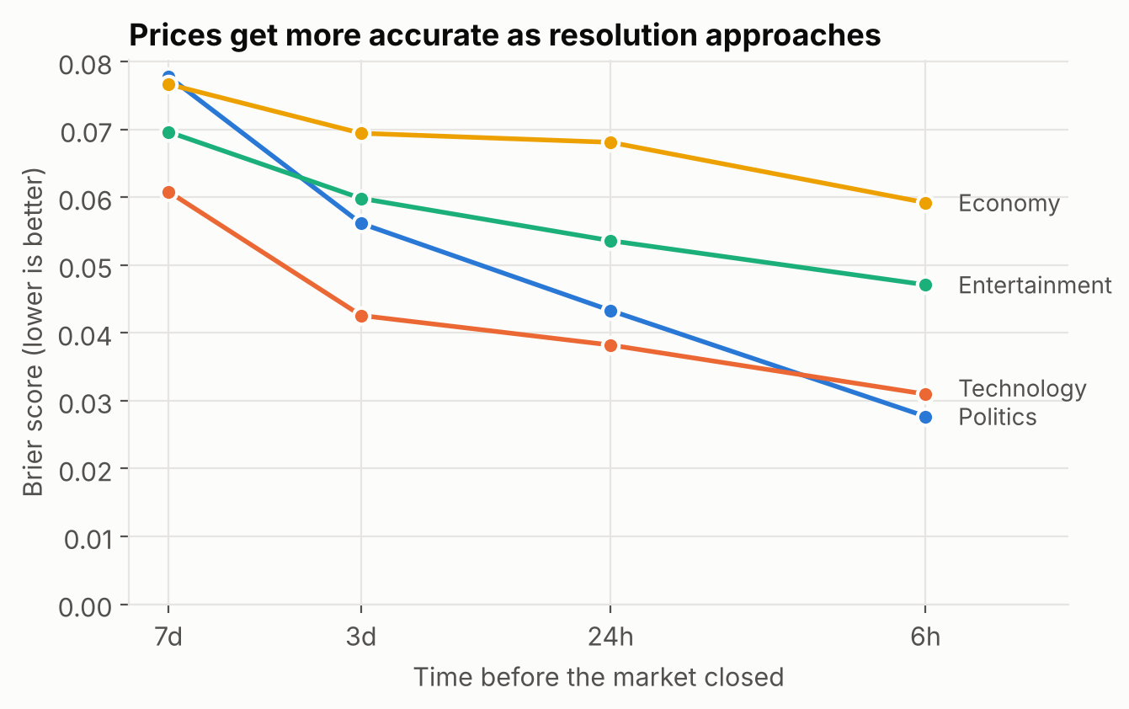
Accuracy near market close
0.074
Overall Brier score at 7 days
0.038
Overall Brier score at 6 hours
Economy retains the largest
error from 3 days to 6 hours.
Lower Brier scores mean more accurate probabilities. Politics shows the largest improvement.
Notes:
AARON (0:40). This figure shows accuracy over time. We use the Brier score, the average squared error of the price, so lower is better. Accuracy improves as the event gets closer. The score falls from 0.074 one week before close to 0.038 six hours before. Politics improves the most, and Economy remains the hardest category near the close.

Slide 9
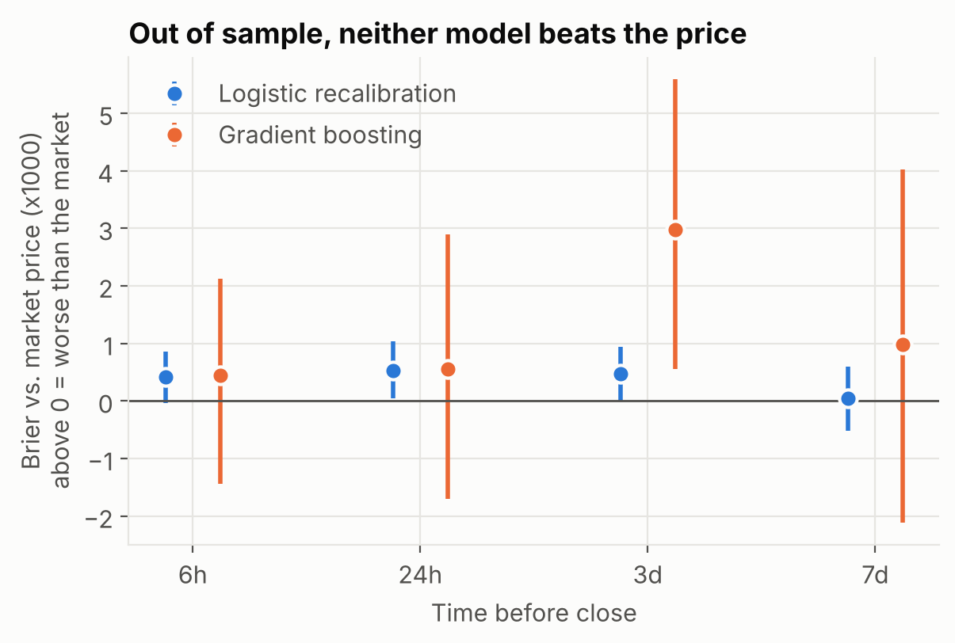
Can models improve on market prices?
Model | 24h Brier
Market price | 0.0513
Logistic recalibration | 0.0518
Gradient boosting | 0.0518
Neither model improves on
market prices in this test.
Train: before September
Test: 860 September–October events
Models use information available at prediction time. In the chart, values above zero indicate worse performance.
Notes:
AARON (1:10). Next, we ask whether a model can beat the price. We trained two models. The first is logistic regression, which adjusts the price to correct small biases by category and by time. The second is gradient boosting, which combines many small decision trees, where each tree corrects the errors of the previous ones. It uses the price plus 18 other features, such as recent price changes, trading volume, and time to the deadline. We trained on markets that closed before September and tested on September and October. Neither model beats the market price. Most of the boosting model's weight is on the price itself. This matches the previous result: a bias that changes every month cannot be learned.

Slide 10
Market findings and limits
Prices broadly match observed outcomes
in all four categories.
Limits
Early resolution changes the
meaning of “24h before close.”
We evaluate one test period.
Favorite–longshot bias is small
and varies across months.
Our models do not improve on prices
in the September–October test period.
Wallet question: which characteristics explain differences in the prices traders choose to pay?
Notes:
AARON (0:50). To summarize, the market is hard to beat. Prices are well calibrated in all four categories. The favorite-longshot bias is small and unstable. And our models do not beat the price. We have two limitations. Some markets close early when the event happens, and we have only one test period. For the final project, this gives us a clear definition. An informed trader is not someone who wins often, because buying at 95 cents wins about 95 percent of the time. An informed trader consistently beats the price they paid. Next, Jiahong will show which wallets pay low prices.

Slide 11
Question and data
How well do wallet characteristics predict average purchase price, and does boosting improve on linear regression?
55,952 wallets
One row per wallet
Target: volume weighted price per share
All wallets retained. Confirmed flag excluded.
Selected event cohort. Prices summarize observed trading history.
Notes:
JIAHONG. Our question is how well wallet trading characteristics predict average purchase price, and whether gradient boosting improves on linear regression. The dataset has 55,952 wallets, one row per wallet. The target is the volume-weighted price of the shares each wallet bought. The histogram shows training wallets. We keep all wallets and exclude the confirmed flag. This cohort comes from five selected event groups, so we describe the wallets in this dataset. A higher or lower purchase price does not by itself tell us whether the wallet made a profit.

Slide 12
Approach
One fixed wallet split
Comparison | Prediction rule
Mean baseline | Training mean for every wallet
Linear regression | Additive associations
Gradient boosting | Nonlinear patterns and interactions
44,761 training wallets
11,191 test wallets
Model selection within training
Five-fold validation selects one of six boosting configurations.
Log-transform five skewed predictors.
Standardize inputs for linear regression.
Inputs: trade count, markets traded, observed span, concentration, spending, largest purchase.
Same test wallets for every model. Primary metric: MAE. Secondary checks: RMSE and R².
Notes:
JIAHONG. We reserve twenty percent of wallets for final evaluation with one fixed random split: 44,761 training wallets and 11,191 test wallets. Every method gets exactly the same test wallets. Five-fold validation happens entirely inside training. We compare a mean baseline, an additive linear regression, and histogram gradient boosting, which can capture nonlinear patterns and interactions. Five skewed predictors use log of one plus the value. We choose boosting settings from a six-configuration grid using validation error, and the test set stays outside model selection.

Slide 13
Results
15.4%
lower MAE than
linear regression
R² 0.368
vs 0.197 for linear regression
Absolute MAE reduction: 3.04 cents
95% paired bootstrap interval: 2.86 to 3.23 cents
11,191 test wallets. Bootstrap intervals condition on the fitted models and assume wallet independence.
Notes:
JIAHONG. On the held-out wallets, the mean baseline has an average absolute error of 22.14 cents per share. Linear regression reduces this to 19.78 cents, and gradient boosting to 16.74 cents. That is a 15.4 percent improvement over linear regression: 3.04 cents, with a paired wallet-bootstrap interval from 2.86 to 3.23 cents. Boosting also has a higher R squared, 0.368 against 0.197. The intervals assume independent wallets, which may be imperfect because wallets can trade in the same markets.

Slide 14
Interpretation
Trade count has the strongest model reliance.
Removing spending and largest purchase raises MAE to 19.97 cents.
Inputs and target come from the same trades.
Price differences can reflect market choice and timing.
Correlated inputs limit attribution. Importance gives no effect direction.
These results do not establish profit, trading skill, or causal effects.
Notes:
JIAHONG. To interpret the model, we shuffle one predictor at a time and measure how much test error rises. Trade count matters most, about 6.32 cents. Spending, largest purchase and number of markets also contribute. This shows what the model relies on, not whether an input raises or lowers the price, and correlated inputs make attribution hard. Removing spending and largest purchase raises boosting error from 16.74 to 19.97 cents, so the money summaries add information. We cannot infer profit, trading skill or causal effects from this.

Slide 15
Questions
Market calibration and wallet behavior
Leo Wong / Aaron Wen / Jiahong Chen
Notes:
Q&A. Likely questions and short answers are on the backup slide and in reports/midterm/slide_script.md.

Slide 16
Additional market checks
Split | Events | Markets
Training | 841 | 3,215
Test | 860 | 3,511
Category | 24h slope
Politics | 1.03
Technology | 1.11
Entertainment | 1.12
Economy | 0.92
Training events close before September 1.
Events crossing that date belong entirely to test.
Mid-range prices: 5¢ to 95¢
Only Entertainment’s interval is just above 1
(95% interval: 1.00 to 1.29, rounded).
24h test Brier: market 0.148, models 0.150.
Notes:
BACKUP. Train/test: no event is on both sides. Mid-range prices: neither model beats the market on 5 to 95 cent prices either. Category slopes: with four categories tested, one borderline interval is not unusual by chance. Other likely questions: why trade prices (the book covered only about 22% of markets; correlation 0.92 where both exist); why resample by event (markets in one event are dependent); why Brier and not accuracy (it is a proper scoring rule; accuracy treats 51% and 99% as the same call).

